Slide 1
ER Modeling
CSC271 – DATABASE SYSTEMS
LECTURE - 06

Slide 2
Today’s Lecture
In this lecture, you will learn the following aspects of ER Model:
Relationships
Cardinality
Identifiers

Slide 3
ER Model - Relationships
name
ssn
lot
since
Employees
name
dname
super-visor
subor-dinate
ssn
lot
did
budget
Works_In
Reports_To
Employees
Departments
Relationship instance – link between entities (corresponds to primary key-foreign key equivalencies in related tables)
Relationship type – category of relationship…link between entity types
Notes:
4

Slide 4
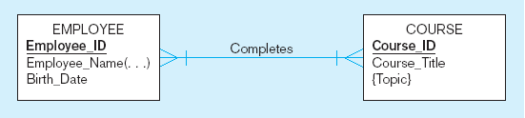
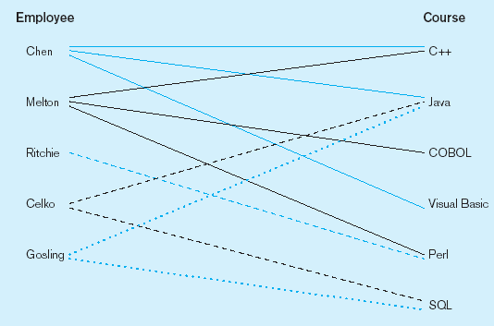
ER Model – Relationship Types vs Instances
Relationship type
Relationship instances
Notes:
17

Slide 5
ER Model – Degree of Relationships
Degree of a relationship is the number of entity types that participate in it
Unary Relationship
Binary Relationship
Ternary Relationship
Notes:
16

Slide 6
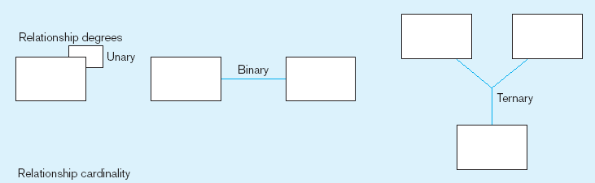
Entities of two different types related to each other
One entity related to another of the same entity type
Entities of three different types related to each other
Notes:
8

Slide 7
Unary relationship
ER Model – Unary Relationships

Slide 8
Binary Relationship
ER Model – Binary Relationships

Slide 9
ER Model – Ternary Relationships

Slide 10
ER Model – Connectivity of Relationships
Connectivity shows the type of relationship as follows:
One-One relationship (1-1)
One-Many relationship (1-M)
Many-Many relationship (M-N)

Slide 11
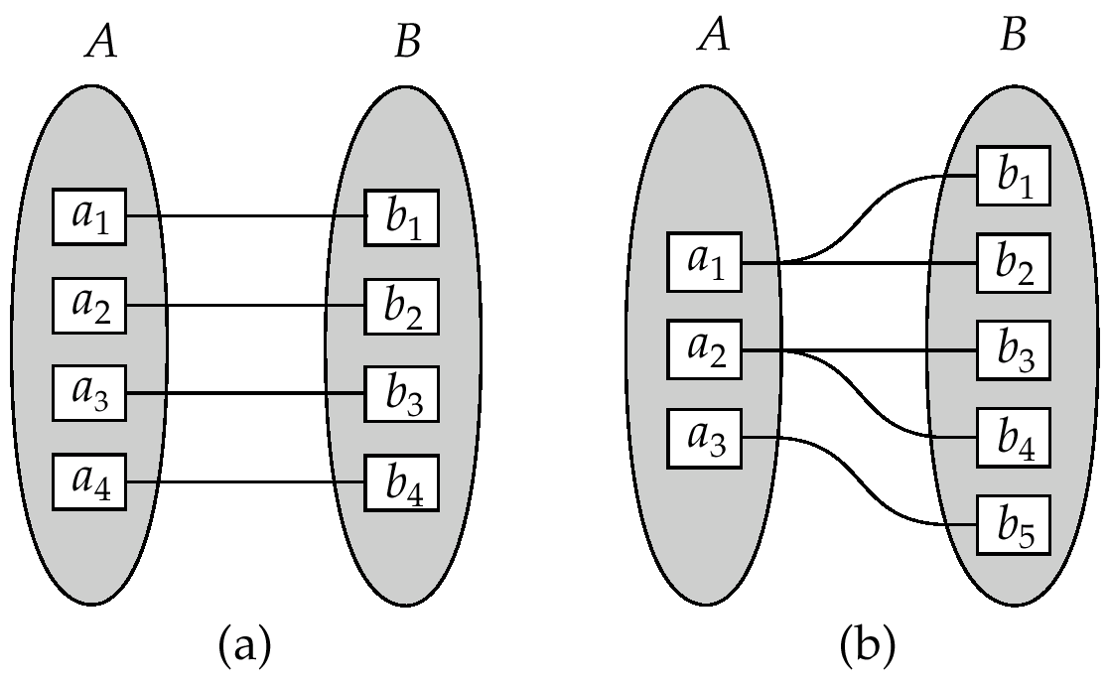
ER Model : One-One & One-Many Relationships

Slide 12
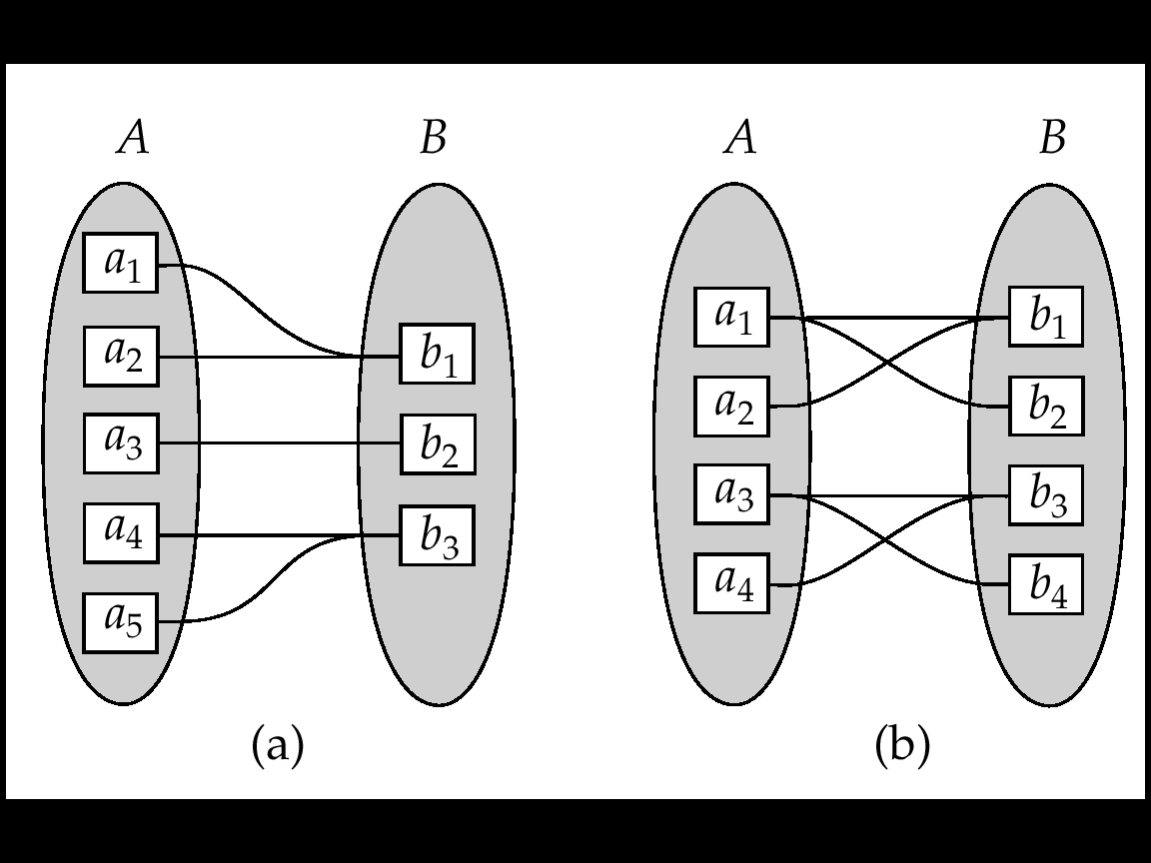
ER Model : Many-One & Many-Many Relationships

Slide 13
ER Model – Cardinality of Relationships
The cardinality of a relationship is the number of instances of entity B that can be associated with entity A.
Cardinality limits are usually derived from the organization's policies or external constraints.
Minimum cardinality
Maximum cardinality
Represented as o or |

Slide 14

ER Model : Cardinality - Example
a video store may stock more than one VIDEOTAPE for each MOVIE, this is a ‘one-to-many’ relationship as in the following Fig.

Slide 15
Minimum cardinality
The minimum cardinality of a relationship is the minimum number of instances of an entity B that may be associated with each instance of an entity A
In our example, the minimum number of VIDEOTAPES of a MOVIE is zero (entity B is an optional participant in the ‘Is_Stocked_As’ relationship)
This is signified by the symbol zero through the arrow near the VIDEOTAPE entity

Slide 16
Maximum cardinality
Is the maximum number of instances of an entity B that may be associated with each instance of entity A
In the following Fig., the maximum cardinality for the VIDEOTAPE entity type is ‘many’ (an unspecified number greater than 1)
This is indicated by the ‘crow’s foot’ symbol on the arrow next to the VIDEOTAPE entity symbol

Slide 17
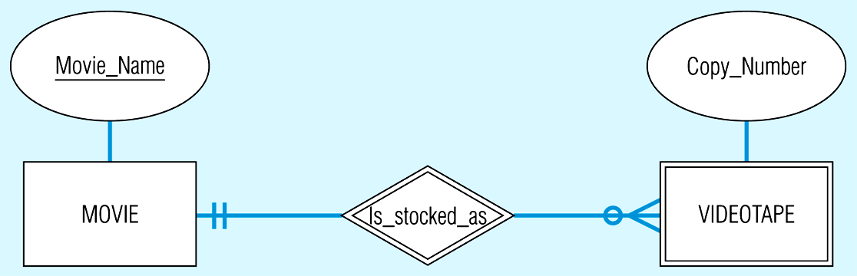
Relationship with cardinality constraints

Slide 18
Example of mandatory cardinality constraints
Each PATIENT has one or more PATIENT_HISTORIES (the initial patient visit is always recorded as an instance of PATIENT_HISTORY)
Each instance of PATIENT_HISTORY ‘Belongs to’ exactly one PATIENT (see following Fig.)

Slide 19
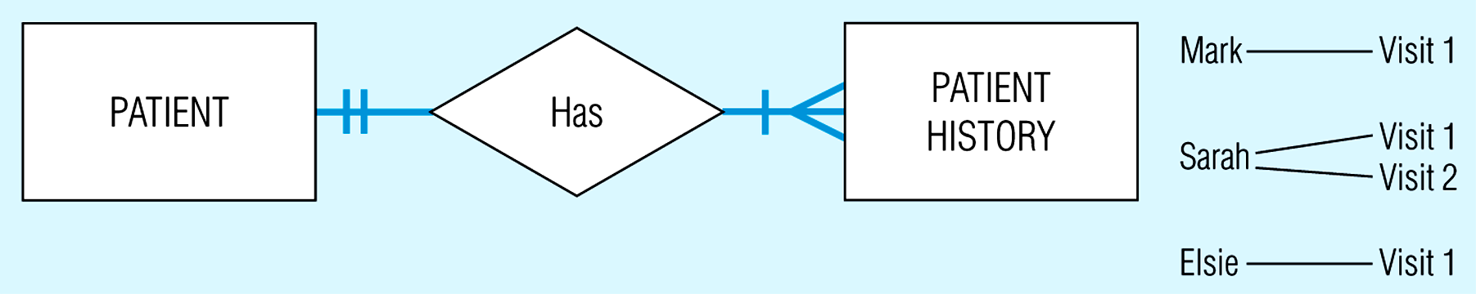
Mandatory cardinalities

Slide 20
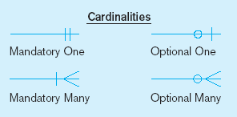
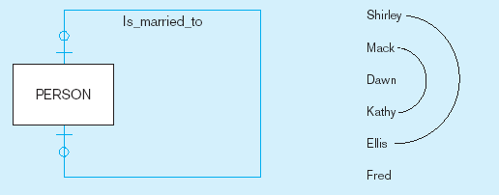
Optional cardinalities
A person is is married to at most one other person, or may not be married at all
Notes:
1

Slide 21
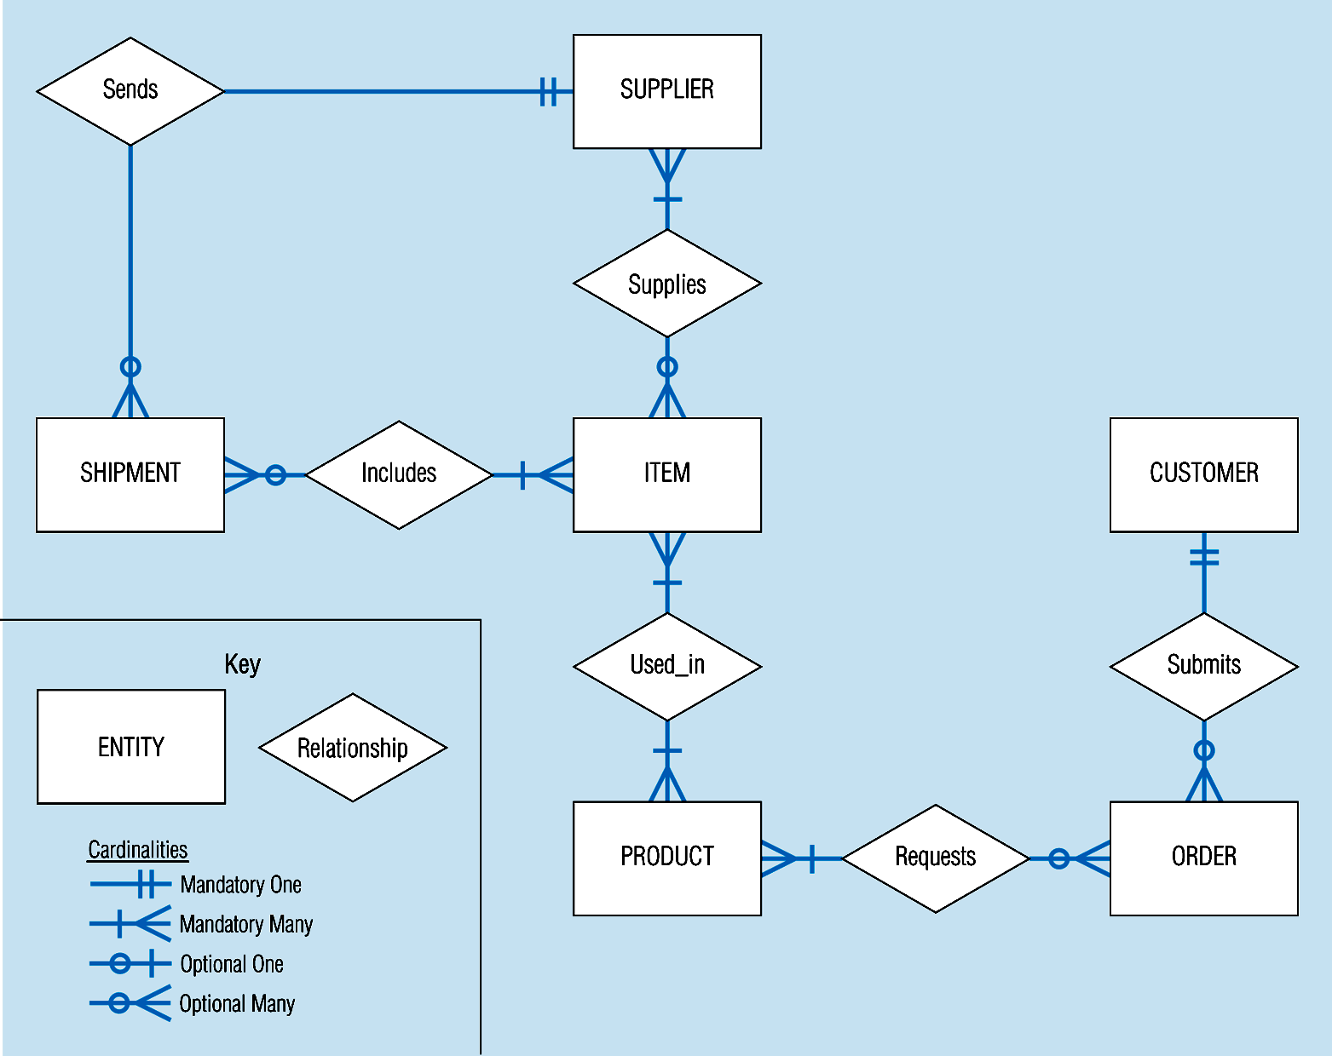

Slide 22
ER Model - Identifiers
Identifier (Key) - An attribute (or combination of attributes) that uniquely identifies individual instances of an entity type
Simple identifier versus Composite identifier
Candidate identifier – an attribute that could be an identifier … satisfies the requirements for being an identifier
Notes:
6

Slide 23
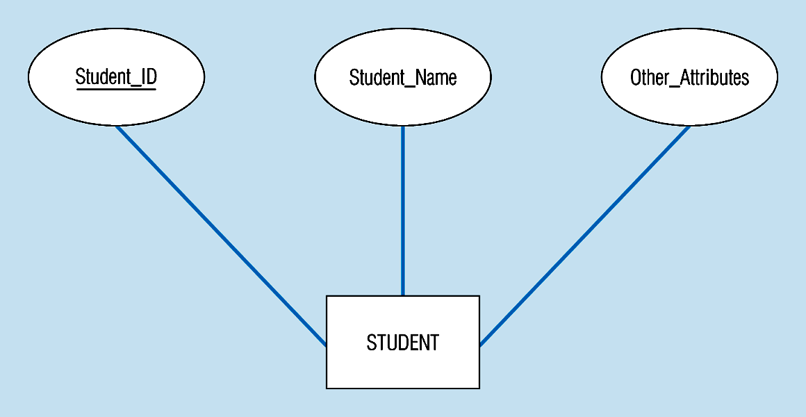
Simple identifier
The identifier is underlined
Notes:
14

Slide 24
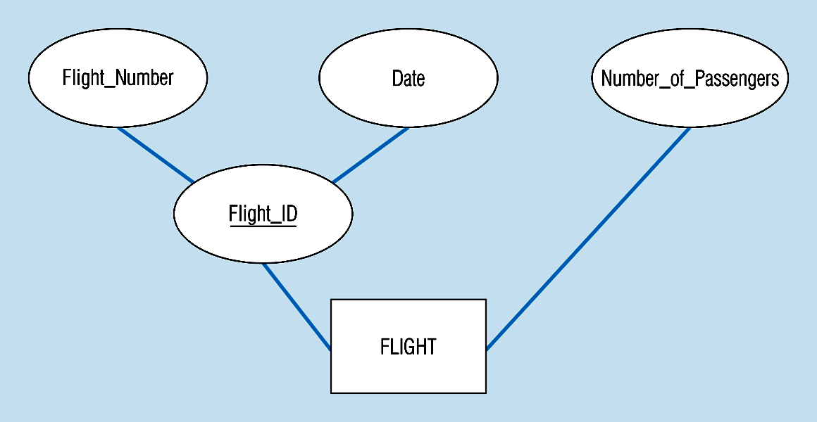
Composite identifier
The identifier is
composed of two subparts
Notes:
15

Slide 25
ER Model – Identifier Characteristics
Will not change in value
Will not be null
No intelligent identifiers (e.g. containing locations or people that might change)
Notes:
7

Slide 26
Er activity
A company has several departments. Each department has a supervisor and at least one employee. Employees must be assigned to at least one, but possibly more departments. At least one employee is assigned to a project, but an employee may be on vacation and not assigned to any projects. The important data fields are the names of the departments, projects, supervisors and employees, as well as the supervisor and employee number and a unique project number.

Slide 27

http://www.thomasformo.com/category/qa/

